Slide 1
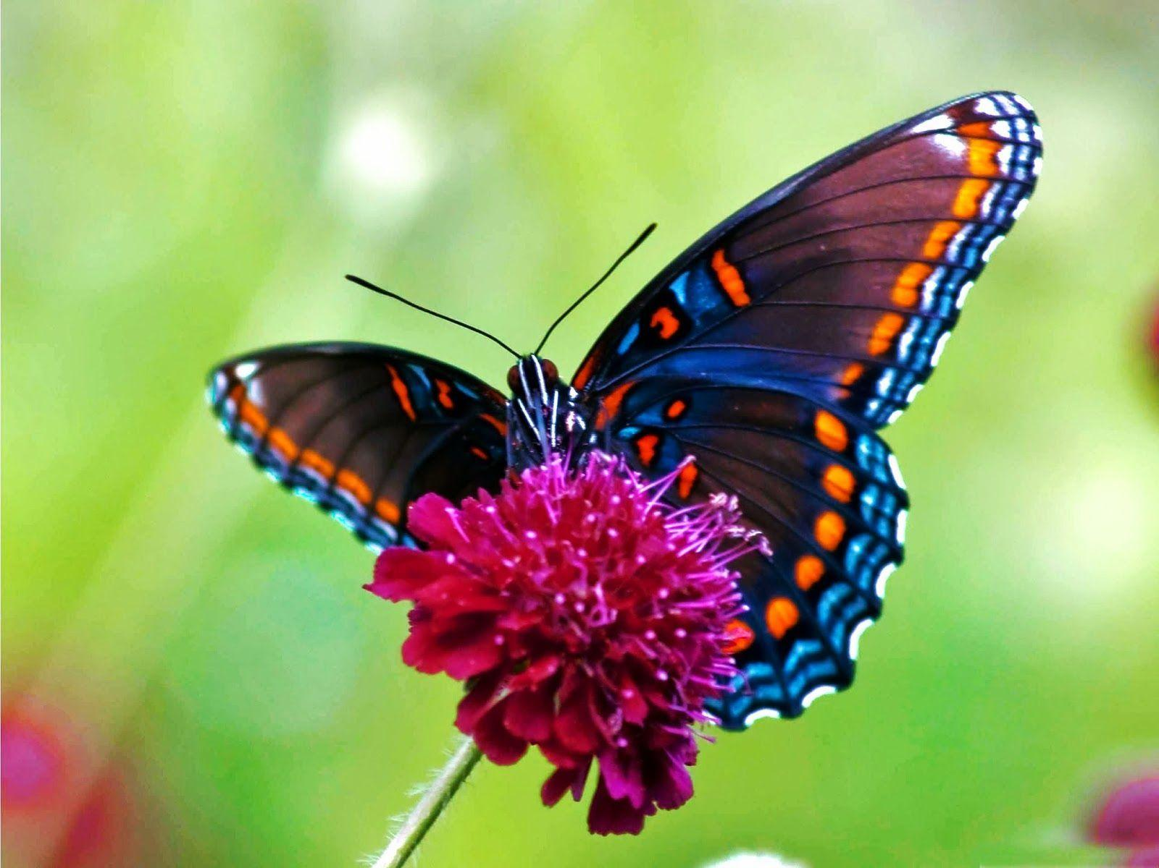
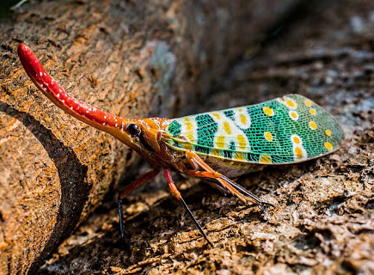
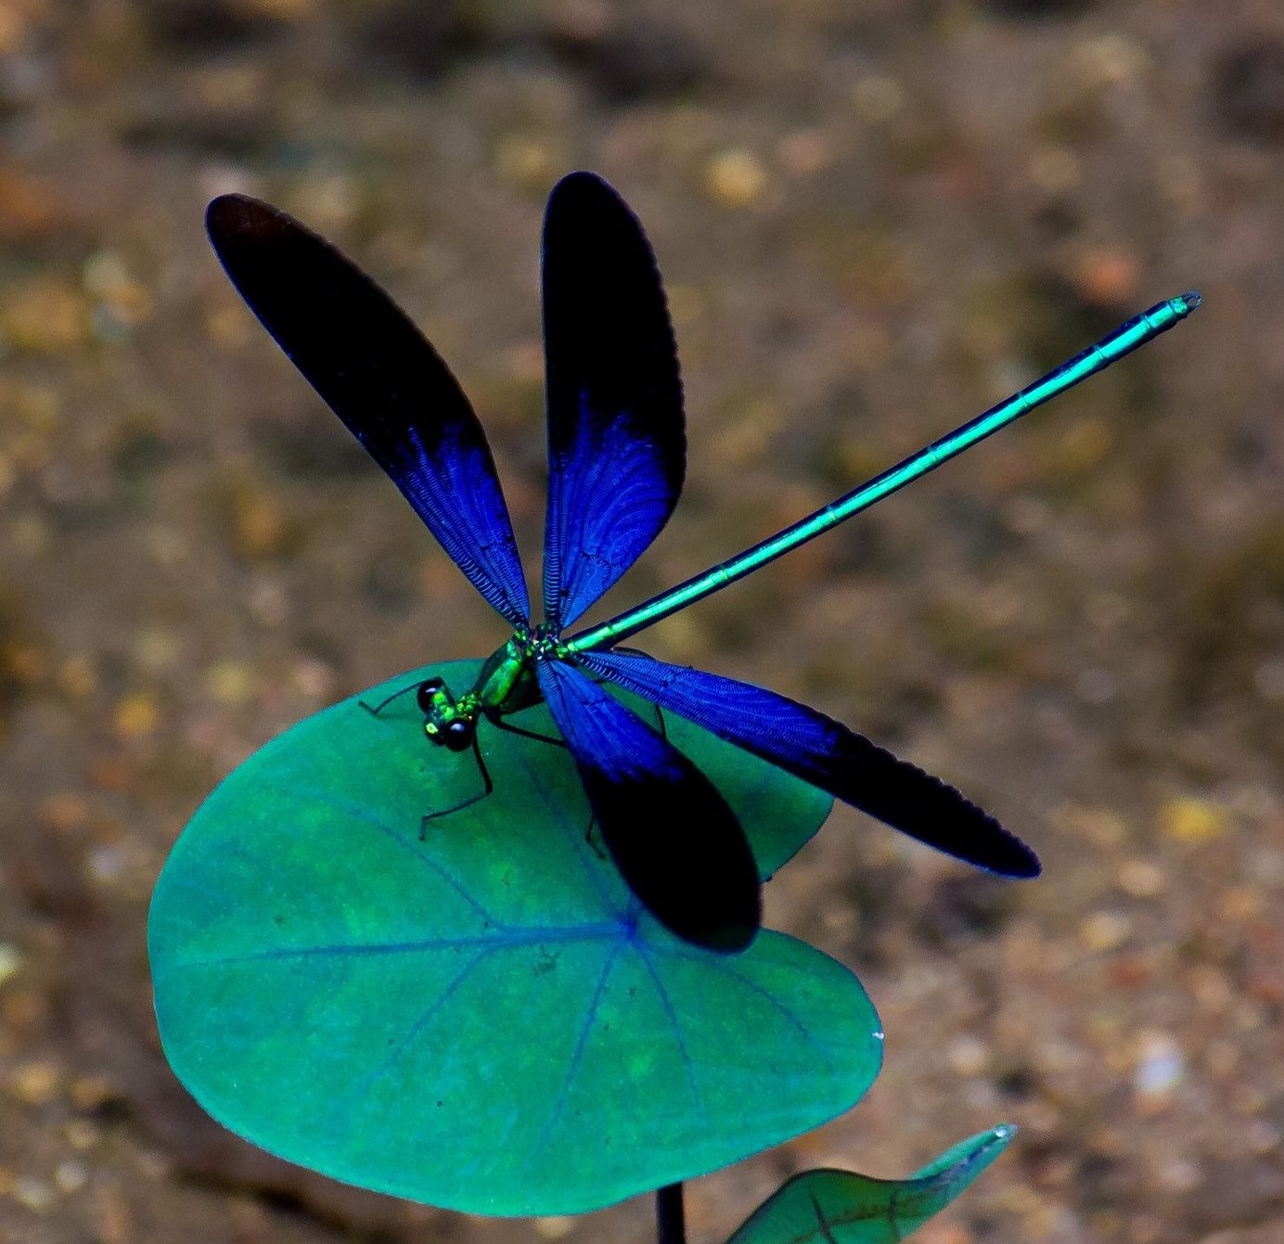
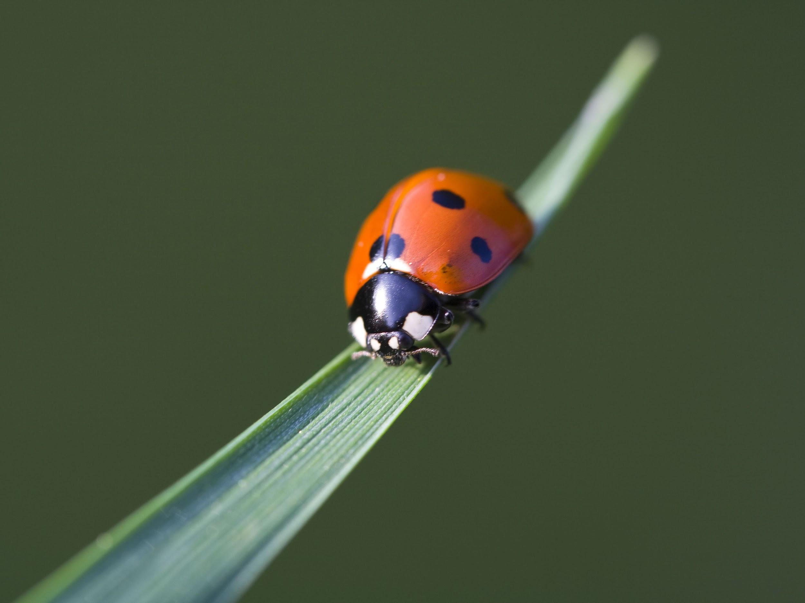
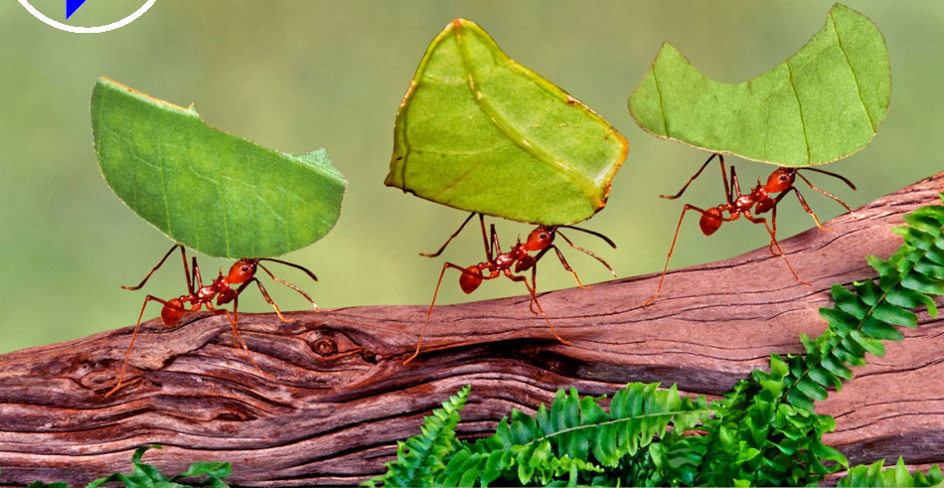
Real-Life SUPERHEROES: INSECTS!
Jenna Ceraso • January 2021
Notes:
As you can see on this slide, insects are an incredibly diverse group

Slide 2
Insect Taxonomy
Notes:
Hymenoptera drawer

Slide 3
How many species of insects do you think there are?
¿Cuantos tipos de insectos hay?
Notes:
One of the reason insects are so biodiverse is because there are SO many species
-ASK QUESTIONS

Slide 4
1,000,000 described species
3-5 million species predicted
About 4,000,000,000,000,000,000 (4 quintillion) bugs total
An Abundance of Insects
Notes:
Over 1 million discovered species
https://www.annualreviews.org/doi/abs/10.1146/annurev-ento-020117-043348
About 4 quatillion bugs!!! In the world!!!

Slide 5
1,000,000 insects described
2.5% of species go extinct every year.
40% of species are endangered.
Notes:
https://www.sciencedirect.com/science/article/pii/S0006320719317823#:~:text=However%2C%20it%20is%20likely%20that,et%20al.%2C%202015).
“It is very rapid. In 10 years you will have a quarter less, in 50 years only half left and in 100 years you will have none.”
More than 40% of insect species are declining and a third are endangered, the analysis found. The rate of extinction is eight times faster than that of mammals, birds and reptiles. The total mass of insects is falling by a precipitous 2.5% a year, according to the best data available, suggesting they could vanish within a century.
https://www.theguardian.com/environment/2019/feb/10/plummeting-insect-numbers-threaten-collapse-of-nature

Slide 6
Why are Insects Important?
¿Por qué son los insectos importante?

Slide 7
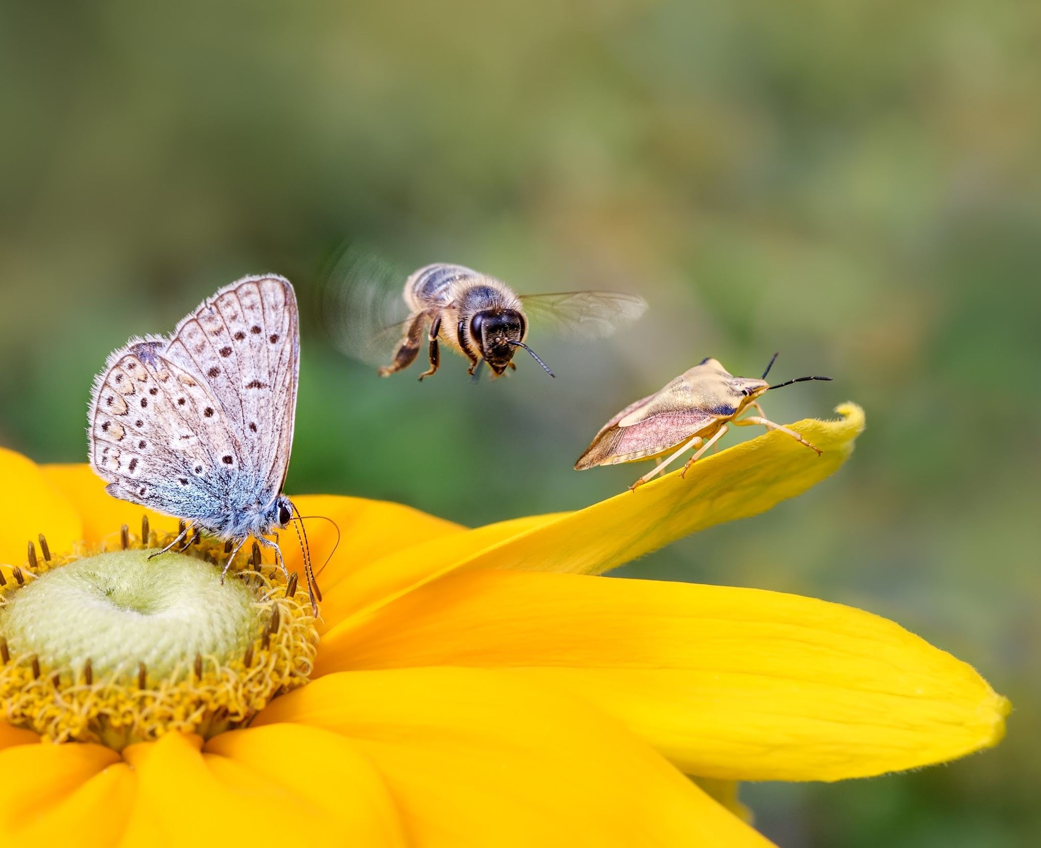
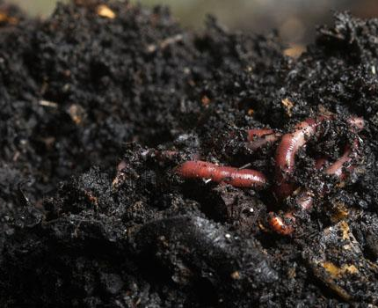
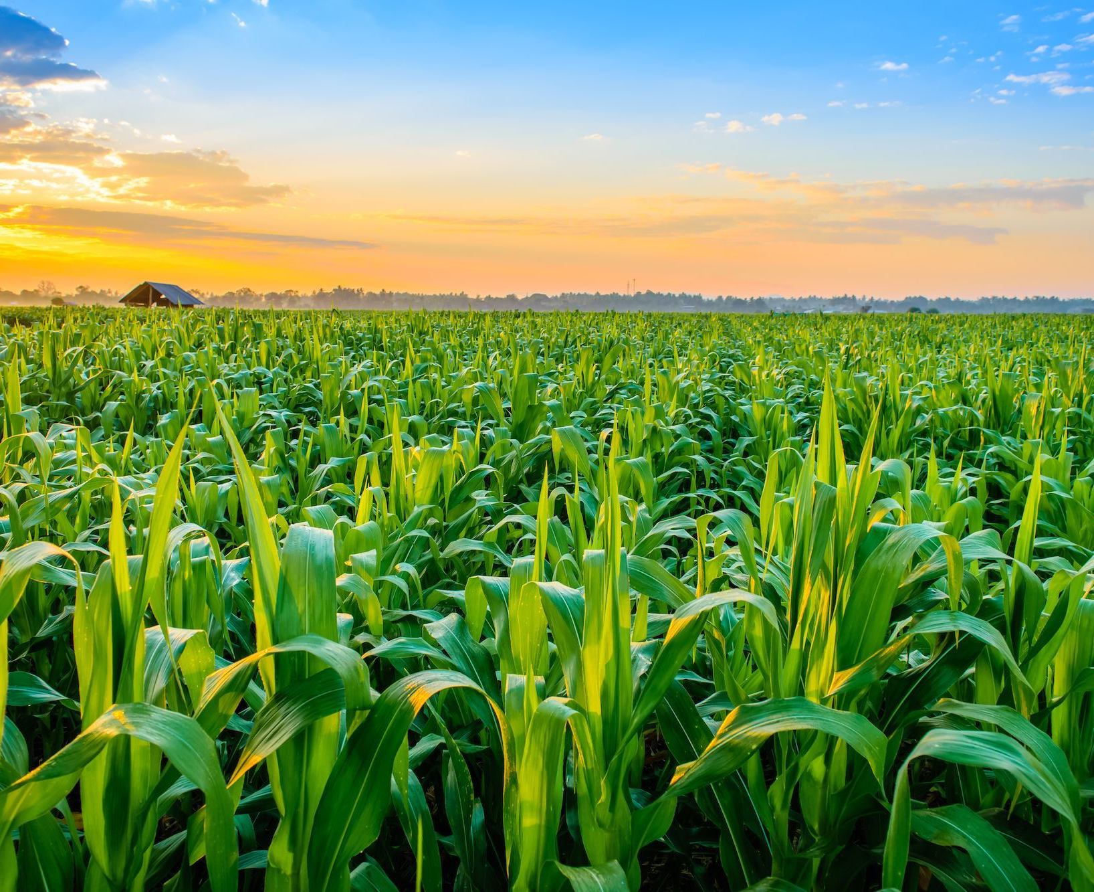
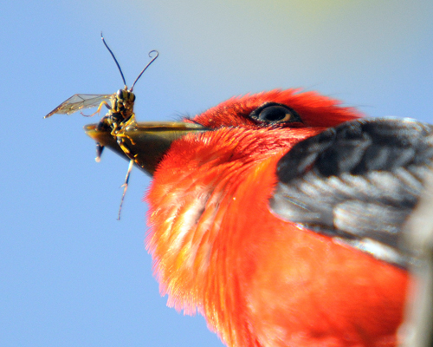
Why are Insects Important?
¿Por qué son los insectos importante?
Notes:
Disperse seeds, pollinate plants, fertile soil, agriculture, food source
Polinizar; hacer la tierra rico, dispersar semillas,
Pueden comer su fruta y verdura?

Slide 8
All food webs have insects as keystone species.
Notes:
Bee eater eating a dragonfly

Slide 9
Insects are essential for decomposition.

Slide 10
Insects help keep other populations from becoming too large.
Notes:
Conehead mantis w/ fritillary (?)

Slide 11
75% of food produced requires pollinators.
Notes:
https://www.fao.org/news/story/en/item/384726/icode/

Slide 12
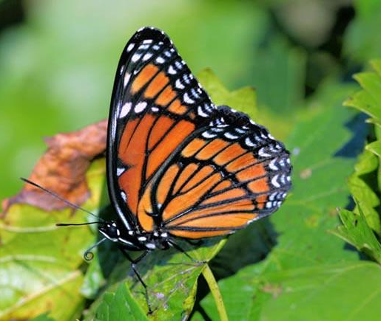
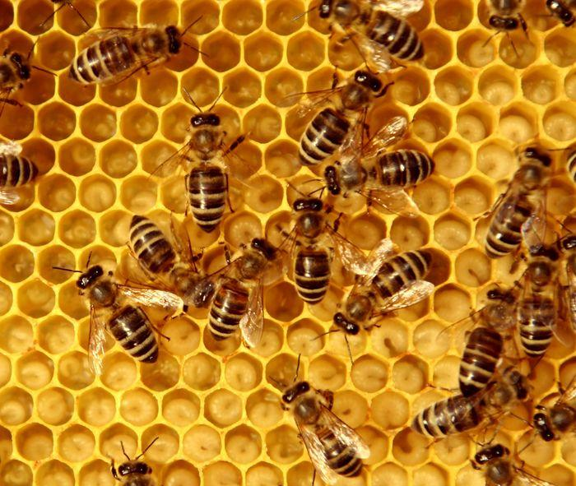
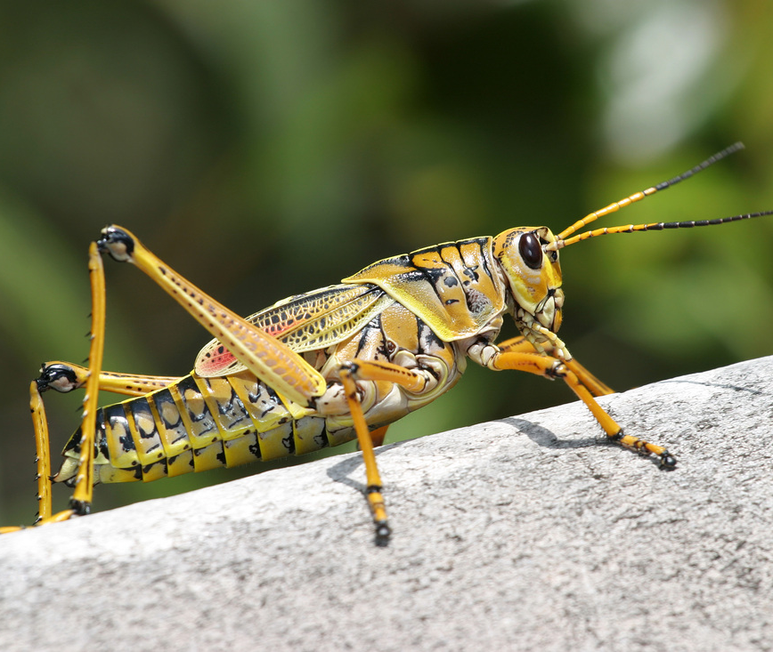
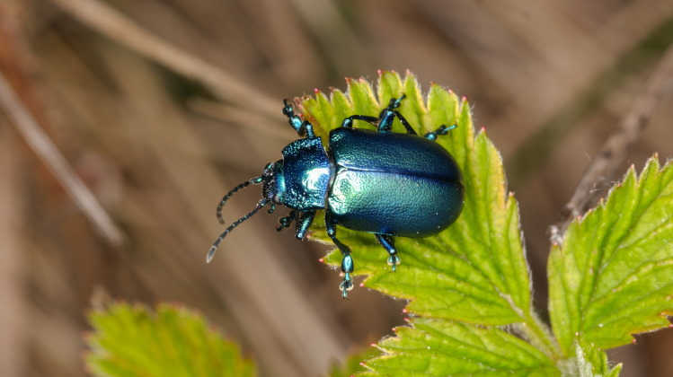
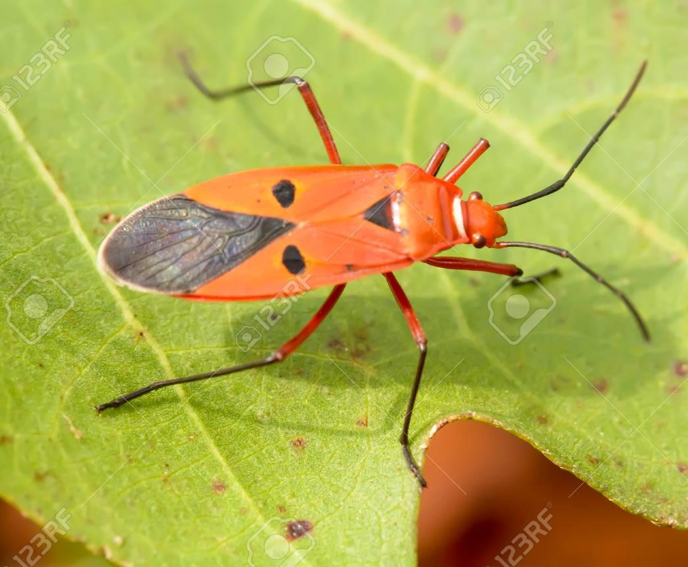
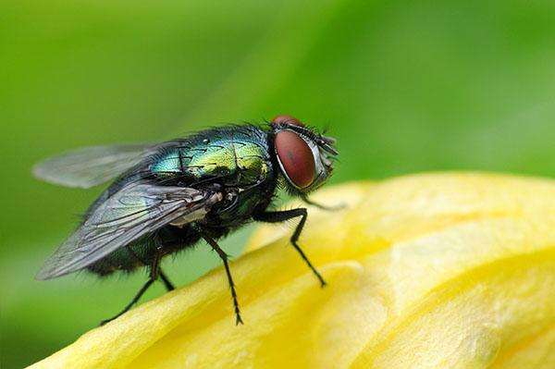
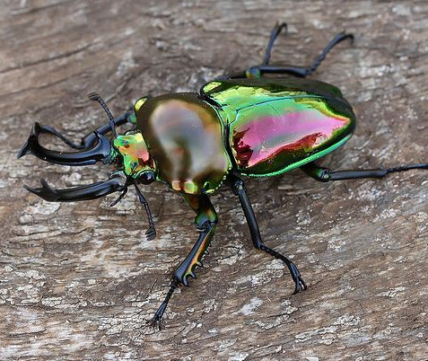
What are insects?
¿Qué son los insectos?
Notes:
Small animals without a backbone with 6 legs
Insects DEFINING CHARACTERISTICS
Flagellomeres without muscles (antenna)
Scape which links to socket and head
Pedicel attaches to scape by muscles and then to the flagellum
Flagellum has no muscles between the body segments
Tentorium (at least posterior arms)
Internal skeleton inside the head
In the most primitive they only have posterior arms
Tarsal claws
Cervical (neck) sclerites
Exoskeleton is flexible by having mitin (??) protein but needs some pivot points to be able to move so they use scleritis
Hardened bits of cartilage (??) that allow for movement = sclerites

Slide 13
All Insects Have...
Antennae las antenas (Flagellomeres)
Skull el cráneo (tentorium)
Claws las garras (tarsal claws)
Cervical Sclerites cartílago duro para que el cuello se pueda mover (hard cartilage that allows neck to move)
Todos Insectos Tienen...
Notes:
Small animals without a backbone with 6 legs
Insects DEFINING CHARACTERISTICS
Flagellomeres without muscles (antenna)
Scape which links to socket and head
Pedicel attaches to scape by muscles and then to the flagellum
Flagellum has no muscles between the body segments
Tentorium (at least posterior arms)
Internal skeleton inside the head
In the most primitive they only have posterior arms
Tarsal claws
Cervical (neck) sclerites
Exoskeleton is flexible by having mitin (??) protein but needs some pivot points to be able to move so they use scleritis
Hardened bits of cartilage (??) that allow for movement = sclerites

Slide 14
What Can Insects Do?
¿Qué pueden los insectos hacer?

Slide 15
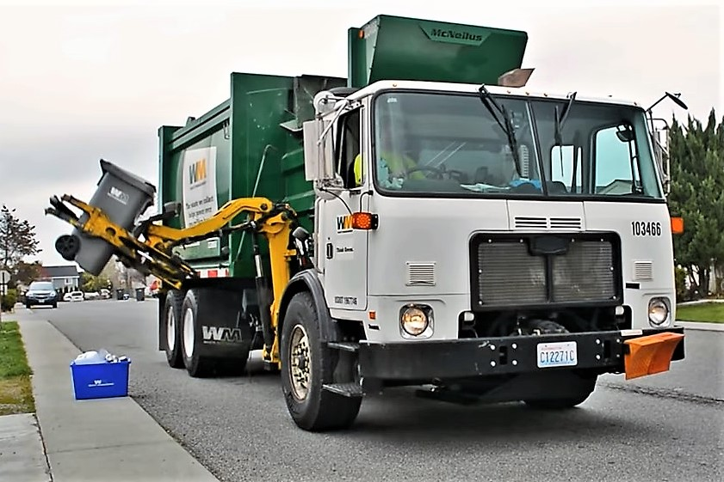
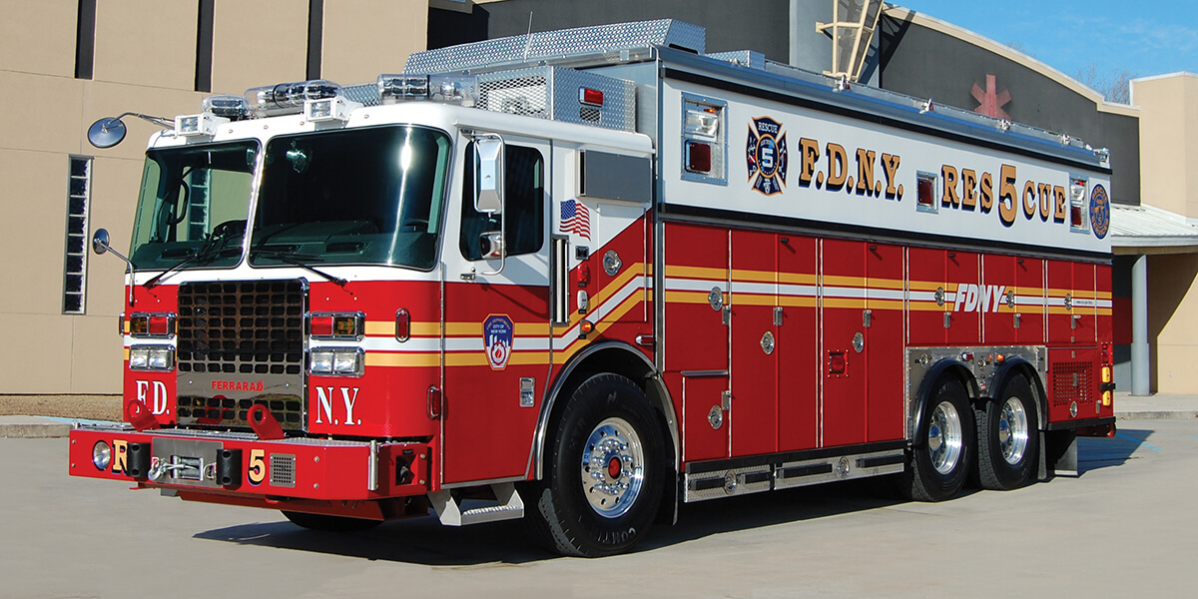
Insect super strength!
What Can Insects Do?
¿Qué pueden los insectos hacer?
Notes:
Ants can lift 5000 times their body weight!!
Thats like you lifting a fire truck or a fully loaded garbage truck!
Las hormigas pueden levantar cinco mil veces su peso corporal
https://entomologytoday.org/2014/02/11/ants-can-lift-up-to-5000-times-their-own-body-weight-new-study-suggests/

Slide 16
Glow in the dark!
What Can Scorpions Do?
¿Qué pueden los insectos hacer?
Notes:
Glow in the dark! Also can be super poisonous! Some scorpions can go over a year without food.
https://animals.sandiegozoo.org/animals/scorpion#:~:text=Scorpions%20don't%20eat%20every,by%20keeping%20insect%20populations%20low.

Slide 17
INSANE engineering!
What Can Insects Do?
¿Qué pueden los insectos hacer?
Notes:
Spider silk is stronger than steel
la seda de araña es más fuerte que el acero
Darwin bark spider can spin webs 25 meters long (2 schoolbuses)
Mujer talla es la anchura de un dedo (18-22mm)
Hombre talla es el mismo de su una (fingernail) (6mm)
https://en.wikipedia.org/wiki/Darwin%27s_bark_spider

Slide 18
Mimicry and crypsis
Disguise experts!!
What Can Insects Do?
¿Qué pueden los insectos hacer?

Slide 19
How fast can you run?
Answer: you’re slow! Around 10 mph.
Super speeds!
What Can Insects Do?
¿Qué pueden los insectos hacer?
Notes:
How fast can you run?
Dragonflies can fly 48km per hour (30 miles per hour), but typically fly 16 km per hour (10 miles per hour).
Corre muy rapido y vuelve en diez segundos.
Generalmente, las libélulas vuelan dieciséis kilos cada hora, pero pueden volar cincuenta kilos cada hora.
https://british-dragonflies.org.uk/odonata/frequently-asked-questions/

Slide 20
Insects can see polarized and UV light.
UV-vision!!
What Can Insects Do?
¿Qué pueden los insectos hacer?
Notes:
On the head mostly
Want to see things you are supposed to avoid
All of the orders have compound eyes (unless blind for some reason like caves)
In many orders (holometabolous orders) nymphs have compound eyes
Ocelli don’t form a good image (light dark detectors)
“Simple” singe lens eyes stemmata (what holometabolous larvae have).
They look at the world with one image with 6 parts
Some have genitalia photoreceptors (swallowtails)
Males need to know when they actually are correctly attached to female before releasing sperm
Male has photoreceptors that detect light so when there is no light they know they are properly in the female
Predators have big eyes
Flat across eyes so acuity is good
Herbivores just need to see if anything is coming at it (bad acuity)
Compound eye is a repeated array of ommatidia (varies from a few dozen to 30,000)
When they shed they shed off the surface of the compound eye
Light goes through and lands on long photoreceptor cells
They get excited and send through axon to optic lobe of brain
Rhabdom = area where the different photoreceptors that all share a lens stick their microvilli
Along the sides there is screening pigment
Pseudo-pupil
As you rotate the eye around there will always be some looking at you
Angles between ommatidia determine spatial acuity cand can vary in different regions of the eye
Because the ommatidia have screening pigment they can only look at a little bit of space
Pongan los lentes

Slide 21
Metamorphosize
What Can Insects Do?
¿Qué pueden los insectos hacer?
Notes:
Ninos ponen un toalla = towel
Run in your house ahora están una mariposa!
Caterpillar = la oruga
Cocoon = capullo
Holometabolous = “classic moulting” egg, larva, pupa, adult
As a pupa different nervous systems happen, they reorganize themselves
More basal groups molt a lot of times as insects are growing, the more derived insects have 2-4 molts

Slide 22
Metamorphosize
UV-vision!!
What Can Insects Do?
¿Qué pueden los insectos hacer?
Notes:
On the head mostly
Want to see things you are supposed to avoid
All of the orders have compound eyes (unless blind for some reason like caves)
In many orders (holometabolous orders) nymphs have compound eyes
Ocelli don’t form a good image (light dark detectors)
“Simple” singe lens eyes stemmata (what holometabolous larvae have).
They look at the world with one image with 6 parts
Some have genitalia photoreceptors (swallowtails)
Males need to know when they actually are correctly attached to female before releasing sperm
Male has photoreceptors that detect light so when there is no light they know they are properly in the female
Predators have big eyes
Flat across eyes so acuity is good
Herbivores just need to see if anything is coming at it (bad acuity)
Compound eye is a repeated array of ommatidia (varies from a few dozen to 30,000)
When they shed they shed off the surface of the compound eye
Light goes through and lands on long photoreceptor cells
They get excited and send through axon to optic lobe of brain
Rhabdom = area where the different photoreceptors that all share a lens stick their microvilli
Along the sides there is screening pigment
Pseudo-pupil
As you rotate the eye around there will always be some looking at you
Angles between ommatidia determine spatial acuity cand can vary in different regions of the eye
Because the ommatidia have screening pigment they can only look at a little bit of space
Pongan los lentes

Slide 23
How can we help our insect superheroes?
¿Cómo podemos ayudar a nuestros superhéroe insectos?

Slide 24
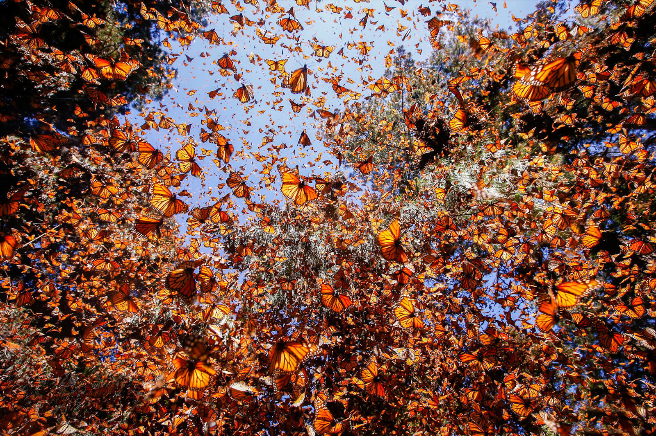
Prevent Habitat Fragmentation & Loss
Notes:
ike many temperate creatures, monarchs migrate south for the winter
Monarch migration is not a round trip but can still be > 5000 km
Individuals from eastern North America fly to Mexico and return only to the southern US
Individuals along California in the southwest
Thus, individuals here in the summer are 3-4 generations descended from lastll year’s monarchs
We don’t know how it is determined which ones stay and which ones go
The daughters of the ones that left Ithaca in the fall might get up into Virginia or something, some hatch out and stay there and others continue their Northward flight
At winter roosts monarch butterflies congregate by the millions
Some glide around off the trees
They need to conserve energy
How do monarch butterflies know where to go
Use the sun
The sun is always in the northern hemisphere
Not great cause sun changes throughout the day
They could adjust accordingly
Morning steer right at sun, noon steer at sun, afternoon steer left of sun
Do monarchs know what time of day it is?
Shifting their clock has no effect on orientation to the sun
If they were shifted six hours, they are very confused
This shows that they have some type of internal clock where they compare what they think the time is to where the sun is
Polarized light and flight oriented behavior (experimente) show that the clock is in the antennae
How do monarchs know when to stop?
Vision? (probably not)
Olfaction? (stinks like monarchs, they have going there for 100s of years)
Use the sun
Polarized light
Magnetic field (not super solid data but maybe)

Slide 25
Stop Polluting!
Pesticide use
Fertilizers
Industrial pollution
Light and sound pollution
Notes:
Bioaccumulation, due to chronic exposure and biomagnification along food chains, pose significant additional threats for insect populations (Hayes and Hansen, 2017) that can have undetected harmful effects on insect physiology and behaviour (Desneux et al., 2007).
Light and noise pollution are becoming increasingly pervasive globally (Morley et al., 2014; Gaston, 2018; Owens and Lewis, 2018), and gaining a better understanding of these novel impacts is critical. Nocturnal insects are especially vulnerable to changes in natural light/dark cycles. Light pollution interferes with insects that use natural light (from the moon or stars) as orientation cues for navigation and with communication of insects that use bioluminescent signals, such as fireflies. It desynchronizes activities triggered by natural light cycles, such as feeding and egg-laying, and causes temporal mismatches in mutualistic interactions (Owens and Lewis, 2018). Noise pollution greatly changes the acoustic landscape and interferes with acoustic communication of insects and their auditory surveillance of the environment, having significant fitness costs (Morley et al., 2014). Finally, the effects of electromagnetic pollution on insects and other life-forms, including humans, are still very badly understood and deserve further exploration (Thielens et al., 2018).

Slide 26
Invasive Species
Lymantria dispar (Spongy Moth)

Slide 27
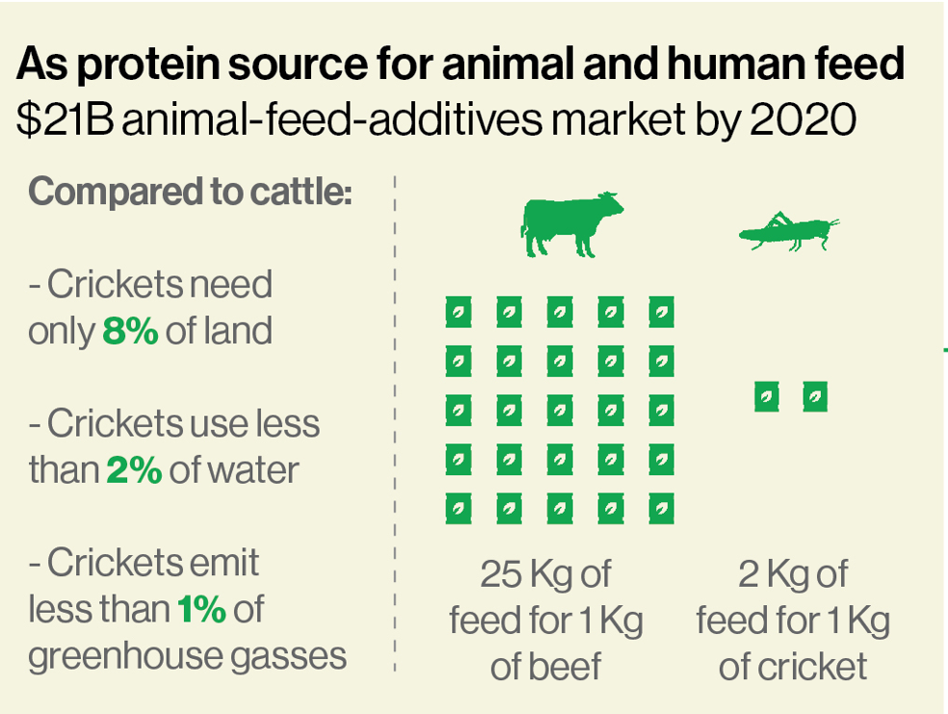
Climate Change
A solution: entomophagy

Slide 28
Insect Identification & Extra Slide Content

Slide 29
What Can Insects Do?
¿Que pueden los insectos hacer?
Notes:
Bees can make honey:
Eat pollen
Becomes honey with enzymes in digestive system
Place honey in the honey comb
Humans can then

Slide 30
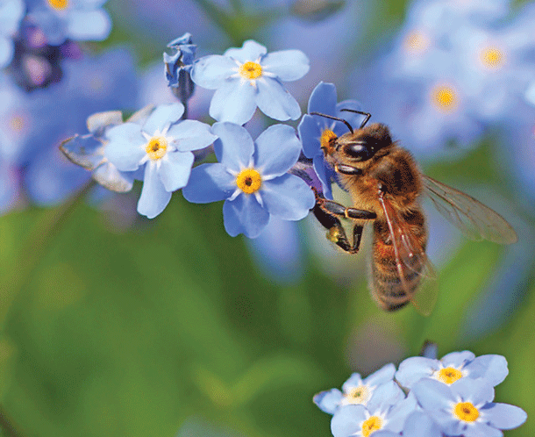
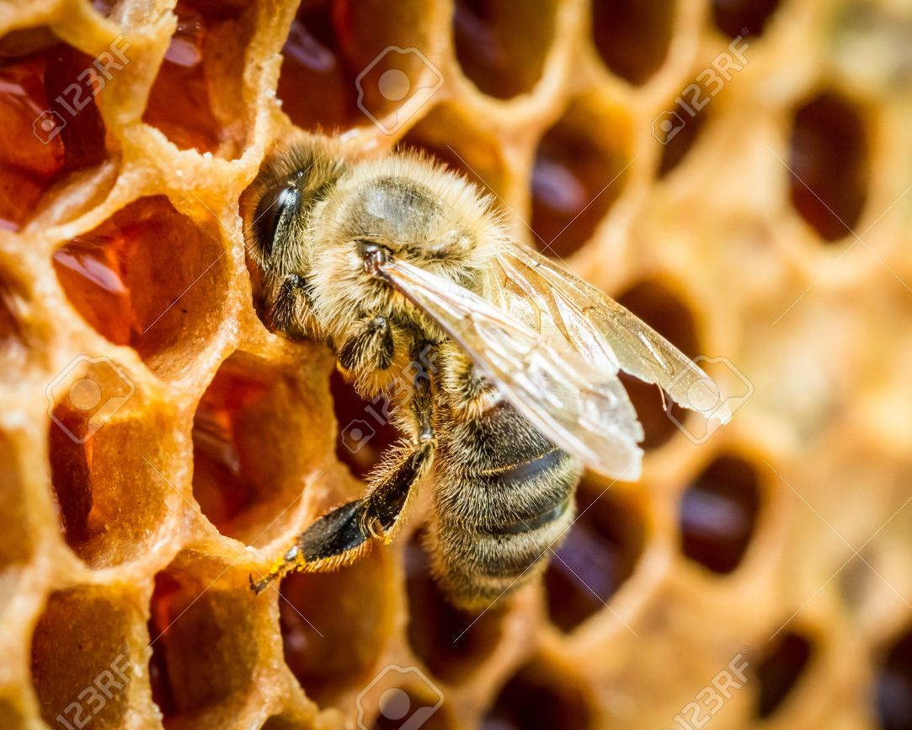
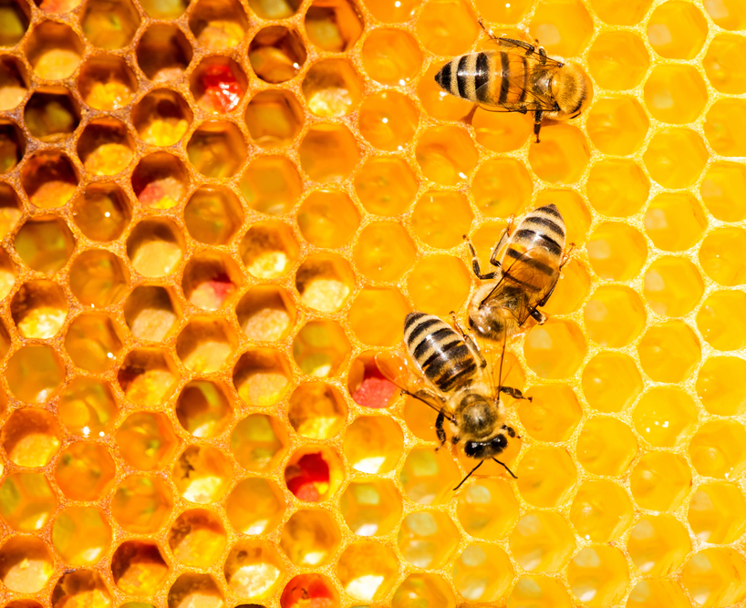
How do bees make honey?
¿Como las abejas producen la miel?
Notes:
Beehive = el panal (o colmena)
Wings = alas
Cap = capa
Bees can make honey:
Eat pollen
Becomes honey with enzymes in digestive system
Place honey in the honey comb
Flap wings fast so the honey dries and place a seal over the honey called a cap

Slide 31
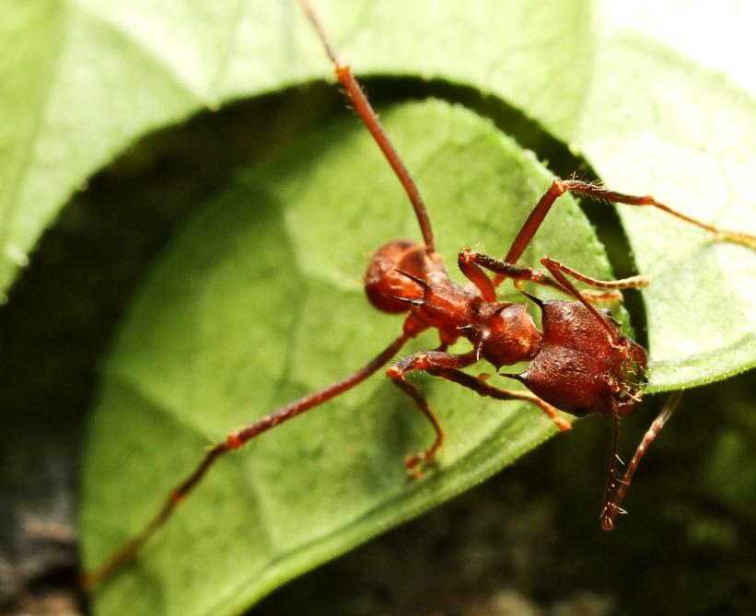
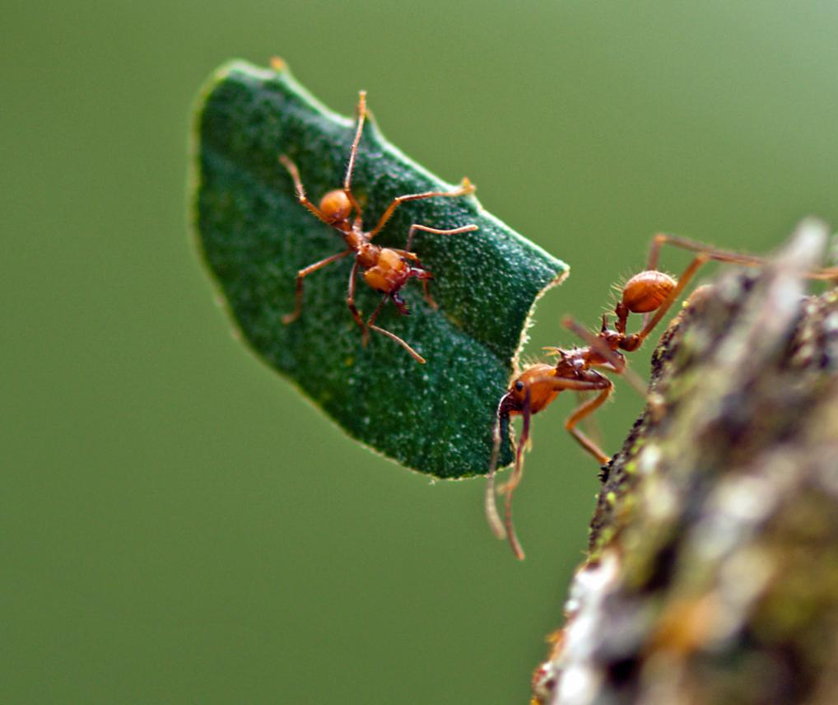
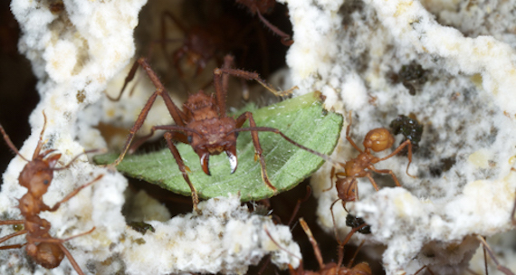
Farmers: Leafcutting Ants!
¡Los hongos, que rico!
Agricultores: ¡Hormigas cortadores de hojas!
Notes:
Leaf = hoja
Nutritivo
Quien has ver una hormiga, levanta un mano!!
Bees can make honey:
Eat pollen
Becomes honey with enzymes in digestive system
Place honey in the honey comb
Flap wings fast so the honey dries and place a seal over the honey called a cap

Slide 32
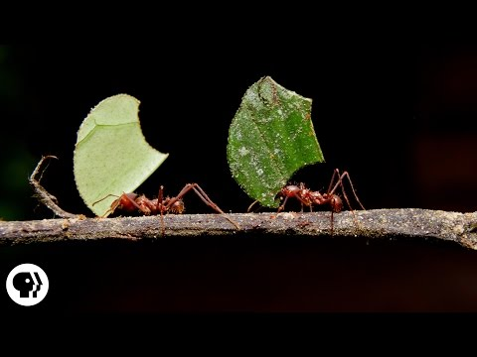
Farmers: Leafcutting Ants!
Agricultores: ¡Hormigas cortadores de hojas!
Notes:
ACTIVITY con papel y agua cortan la papel

Slide 33
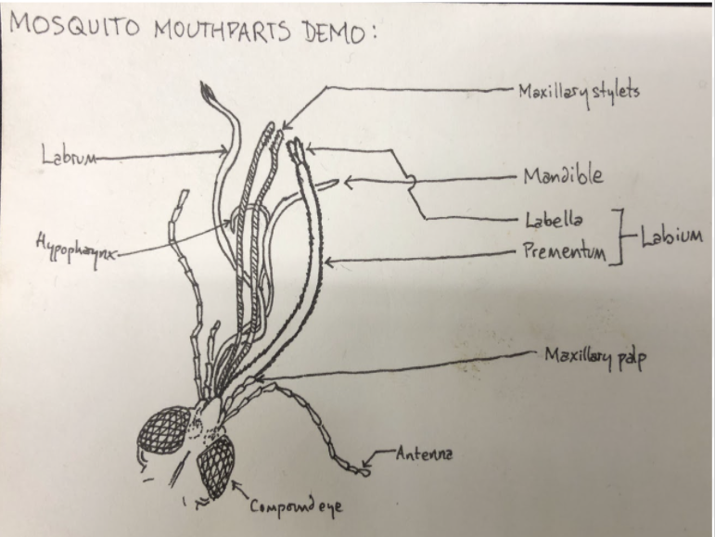
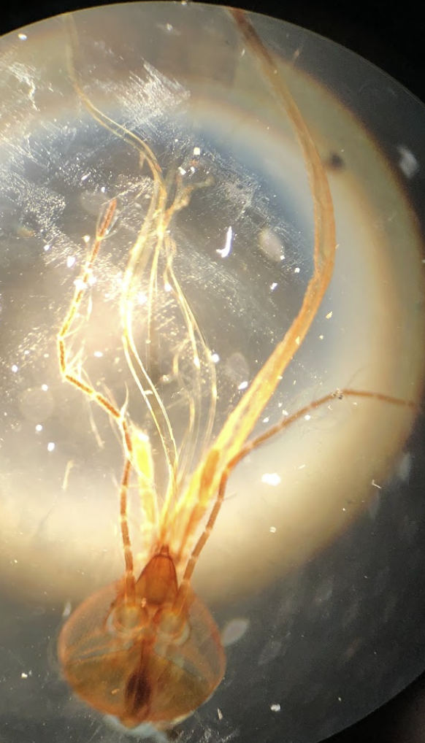
Mouthparts

Slide 34
Thank you! Questions?

Slide 35
Citations
https://entomologytoday.org/2014/02/11/ants-can-lift-up-to-5000-times-their-own-body-weight-new-study-suggests/
https://www.annualreviews.org/doi/abs/10.1146/annurev-ento-020117-043348
https://en.wikipedia.org/wiki/Darwin%27s_bark_spider
https://british-dragonflies.org.uk/odonata/frequently-asked-questions/
The rest is from my class notes from the class Insect Biology with Prof. Cole Gilbet @ Cornell University
And then videos and photos are from various sources and were not taken by me!

